Slide 1
LEX & YACC USING FLEX & BISON

Slide 2
OUTLINE
Lex:
    Theory.
    Execution.
    Example.
Yacc:
    Theory.
    Description.
    Example.
Lex & Yacc linking.
    Demo.

Slide 3
LEX
lex is a program (generator) that generates lexical analyzers, (widely used on Unix).
It is mostly used with Yacc parser generator.
Written by Eric Schmidt and Mike Lesk.
It reads the input stream (specifying the lexical analyzer ) and outputs source code implementing the lexical analyzer in the C programming language.
Lex will read patterns (regular expressions); then produces C code for a lexical analyzer that scans for identifiers.

Slide 4
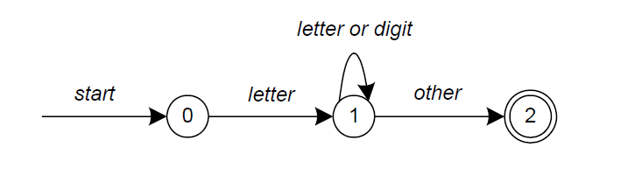
LEX
  A simple pattern: letter(letter|digit)*
Regular expressions are translated by lex to a computer program that mimics an FSA.
This pattern matches a string of characters that begins with a single letter followed by zero or more letters or digits.

Slide 5
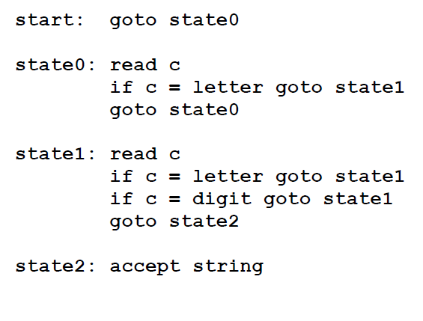
LEX
Some limitations, Lex cannot be used to recognize nested structures such as parentheses, since it only has states and transitions between states.
So, Lex is good at pattern matching, while Yacc is for more challenging tasks.

Slide 6
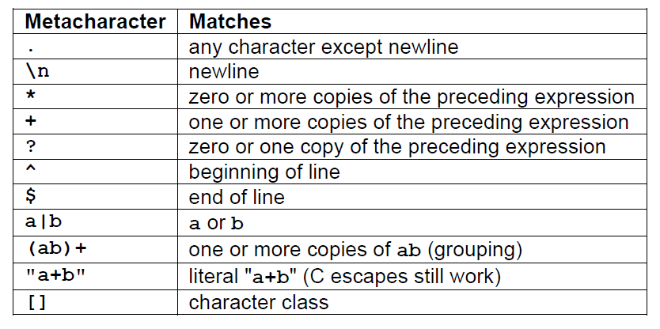
LEX
Pattern Matching Primitives

Slide 7
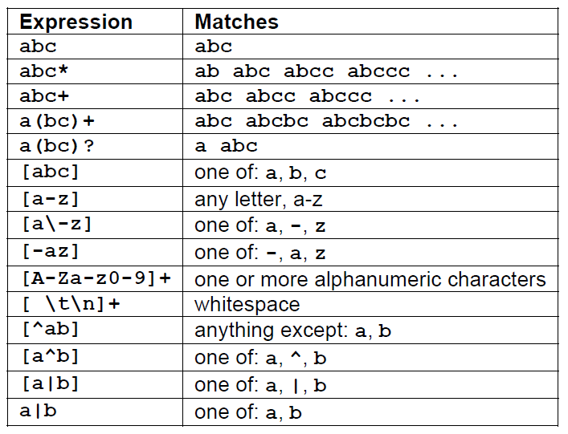
LEX
Pattern Matching examples.

Slide 8
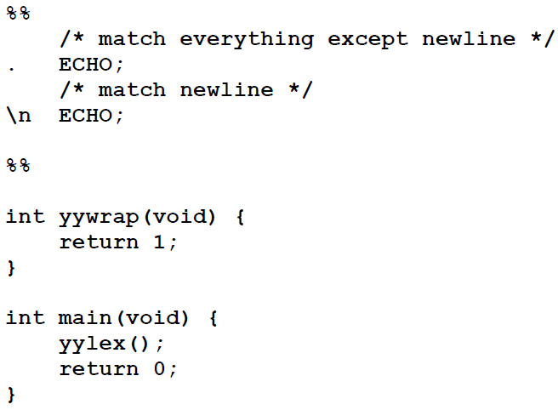
LEX
……..Definitions section……
%%
……Rules section……..
%%
……….C code section (subroutines)……..
The input structure to Lex.
Echo is an action and predefined macro in lex that writes code matched by the pattern.

Slide 9
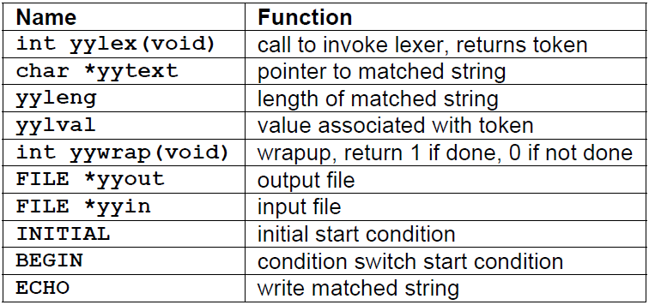
LEX
Lex predefined variables.

Slide 10
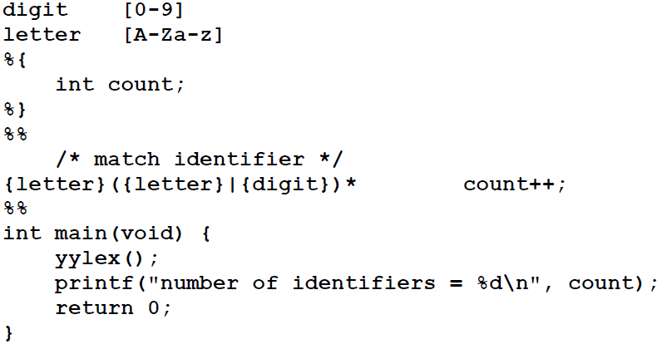
LEX
Whitespace must separate the defining term and the associated expression.
Code in the definitions section is simply copied as-is to the top of the generated C file and must be bracketed with “%{“ and “%}” markers.
substitutions in the rules section are surrounded by braces ({letter}) to distinguish them from literals.

Slide 11
YACC
Theory:
  Yacc reads the grammar and generate C code for a parser .
  Grammars written in Backus Naur Form (BNF) .
  BNF grammar used to express context-free languages .
  e.g. to parse an expression , do reverse operation( reducing the expression)
  This known as bottom-up or shift-reduce parsing .
  Using stack for storing (LIFO).

Slide 12
YACC
Input to yacc is divided into three sections.
... definitions ...
%%
... rules ...
%%
... subroutines ...

Slide 13
YACC
The definitions section consists of:
  token declarations .
  C code bracketed by “%{“ and “%}”.
  the rules section consists of:
    BNF grammar .
the subroutines section consists of:
  user subroutines .

Slide 14
YACC& LEX IN TOGETHER
The grammar:
program -> program expr | ε
expr -> expr + expr | expr - expr | id
Program and expr are nonterminals.
Id are terminals (tokens returned by lex) .
expression may be :
  sum of two expressions .
  product of two expressions .
  Or an identifiers

Slide 15
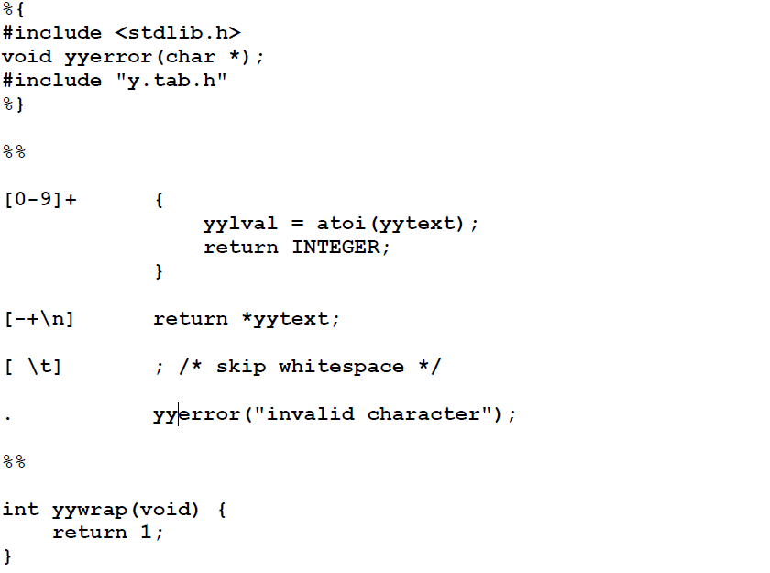
LEX FILE

Slide 16
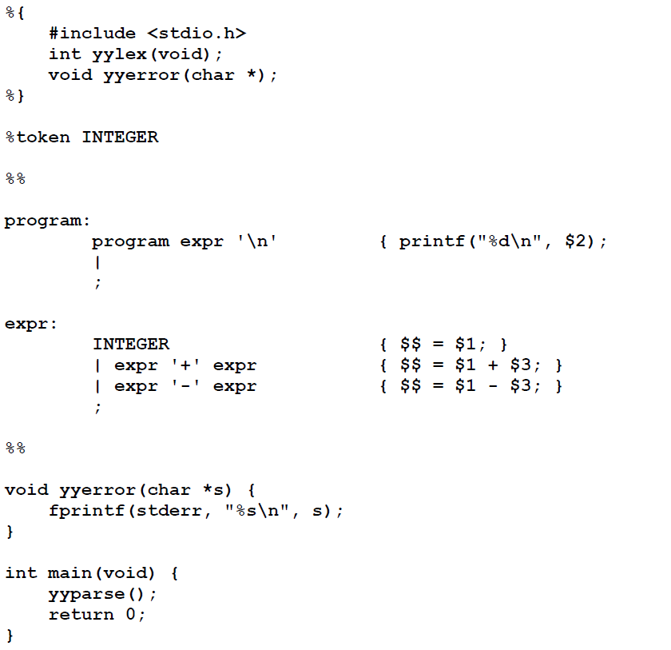
YACC FILE

Slide 17
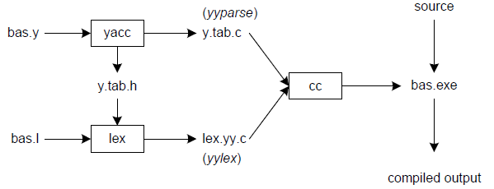
LINKING LEX&YACC

Slide 18
OFFLINE ASSIGNMENT
Design a Simple calculator that can support the following operations:
"+" : plus operation: Example: 5 + 8 := 13
"-" : minus operation: Example: 5 - 8 := -3
"++" : increment: Example: 3 + 6++ := 10 ; 3 + ++6 := 10
"--" : decrement: Example: 3 + 6-- := 8 ; 3 + --6 := 8
"<<" : LEFTSHIFT operation: Example: 6 << 2 := 24
">>" : RIGHTSHIFT operation: Example: 6 >> 1 := 3
Hathal & Ahmad

Slide 19
OFFLINE ASSIGNMENT CONT.
"/" : DIV operation: Example: 6 / 1 := 6 [note that 6 / 0 := Infinity, you have to handle this.]
"*" : MUL operation: Example: 6 * 2 := 12
"%" : MOD operation: Example: 6 % 10 := 6 [only on integer operands, otherwise handle the error]
"**" : DOUBLESTERIK operation: Example: 6 ** 2 := 36 [power: 6^2]
[Note: 1.You also have to handle UNARY MINUS operation!!!!!. Example: 33 - -2:= 35
2.You also have to handle UNARY PLUS operation!!!!!. Example: 33 - +2:= 31 ]
Hathal & Ahmad

